Slide 1
Team Are We There Yet
Design Presentation

Slide 2
Introduction
Project Mission
Play the game “Simon” for 15 seconds
Pick up a playing card and carry it across the finish line
Twist one row of a Rubik’s cube 180 degrees
Draw “IEEE” on an Etch-A-Sketch
Line follow
Complete round in 5 minutes or less

Slide 3
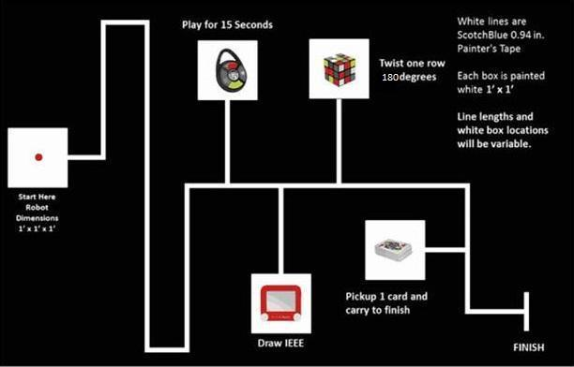
Competition Course

Slide 4
Timeline
18 September 2014 – Preliminary Requirements
10 October 2014 – Preliminary Budget
18 November 2014 – Integrated Prototype
25 November 2014 – Revised Requirements
12 December 2014 – Preliminary Design Document

Slide 5
Budget
Proposed budget: $654.52
Total spent: $560.21

Slide 6
Design Solution
Process
Identify when light in starting area goes out
Line follow to first challenge
Complete challenge
Line follow to second, third and fourth challenges, completing each
Cross finish line

Slide 7
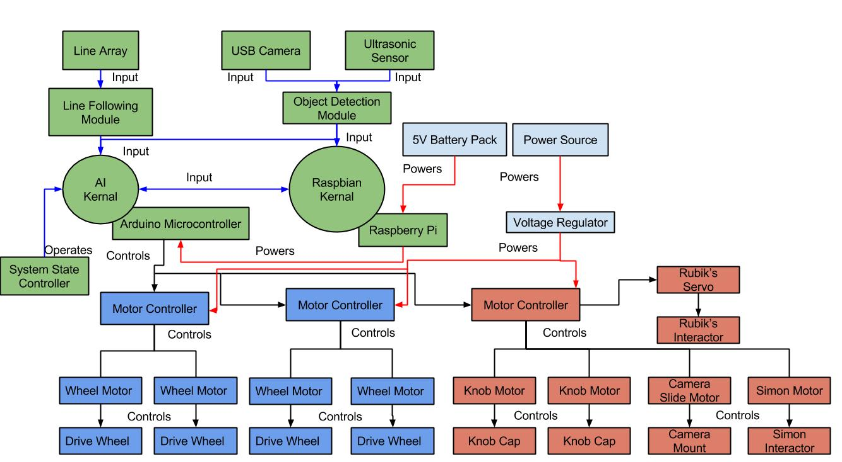
System Architecture

Slide 8
Design Considerations
Assumptions and dependencies
Operation
Rule changes
General Constraints
Size
Power consumption
Safety Constraints and Considerations
Electrical hazards
System heating

Slide 9
Subsystems
Coordination Subsystem
Reads input from sensors
Directs other subsystems
Movement Subsystem
Contains all components responsible for moving system
Challenge Subsystem
Contains all components responsible for completing challenges

Slide 10
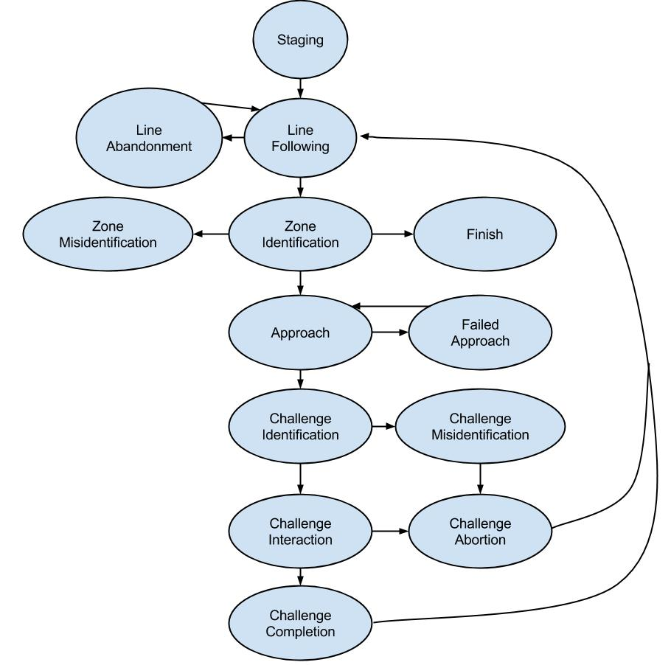
Coordination Subsystem
Purpose
Progresses system through state diagram
“Master” of system
Responsibilities
Read input from sensors
Interpret sensor reading
Activate corresponding subsystem

Slide 11
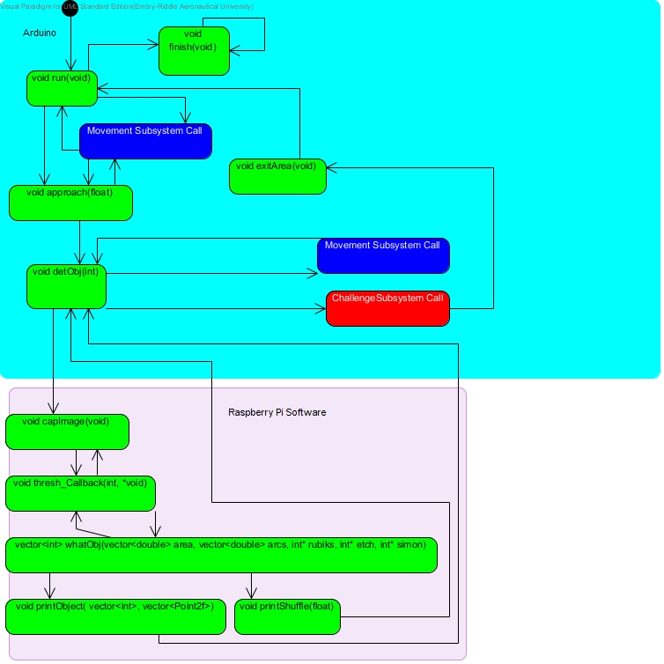
Functional Diagram

Slide 12
Parts List
Raspberry Pi B+
Arduino Mega 2560
QTR-8A Line Sensor Array
USB Camera
Ultrasonic Sensor

Slide 13
Movement Subsystem
Purpose and Responsibility
Performs all movement operations
Motors and wheels
Chassis
Constraints
Fit within starting area
Maintain contact with course floor

Slide 14
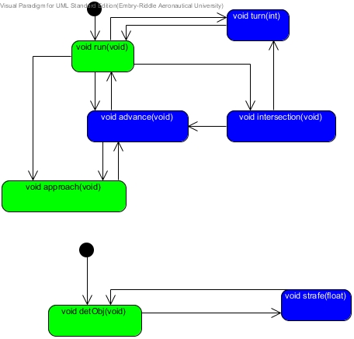
Functional Diagram

Slide 15
Parts List

Slide 16
Chassis
2 tiers
(weight)
(dimensions)

Slide 17
Motors
Motor stuff

Slide 18
Wheels
Wheel stuff

Slide 19
Battery
Battery stuff

Slide 20
Challenge Subsystem

Slide 21
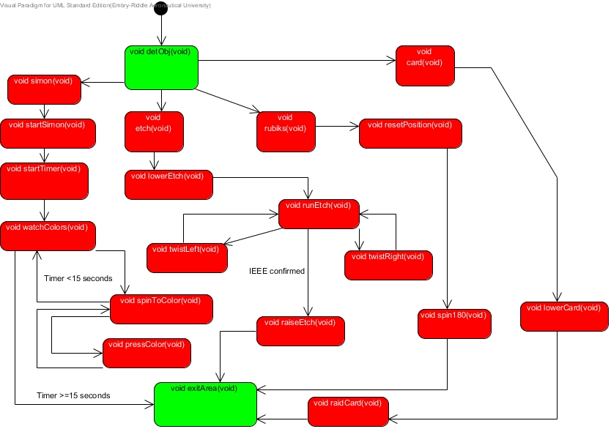
Functional Diagram

Slide 22
Parts List

Slide 23
Simon Interactor
Information about interactor

Slide 24
Rubik’s Cube and Card Interactor
Information about interactor

Slide 25
Etch-A-Sketch Interactor
Information about interactor

Slide 26
Video of Performance

Slide 27
Semester Re-cap
Accomplishments
Goals for next semester

